Slide 4
GOD IS A GOD OF NEW BEGINNINGS
Creation
Post flood
Calling of Abraham – Israel
Nineveh
Incarnation – Crucifixion – Resurrection
New Creation
COMMUNION

Slide 5
NEW YEAR RESOLUTIONS
a desire for a better future
spiritual, emotional, familial, financial, intellectual, career, work-life balance & etc
< 25% stay committed to resolutions after just 30 days and only 8% accomplish them [FORBES: 2018]

Slide 6
EVERYTHING SIGNIFICANT BEGINS WITH THE FIRST STEP
The story of James McQuilkin in Answers to prayer from the narratives of George Meuller pp. 37-38 compiled by A.E.C. BROOKS. Moody Press, Chicago 1983

Slide 7
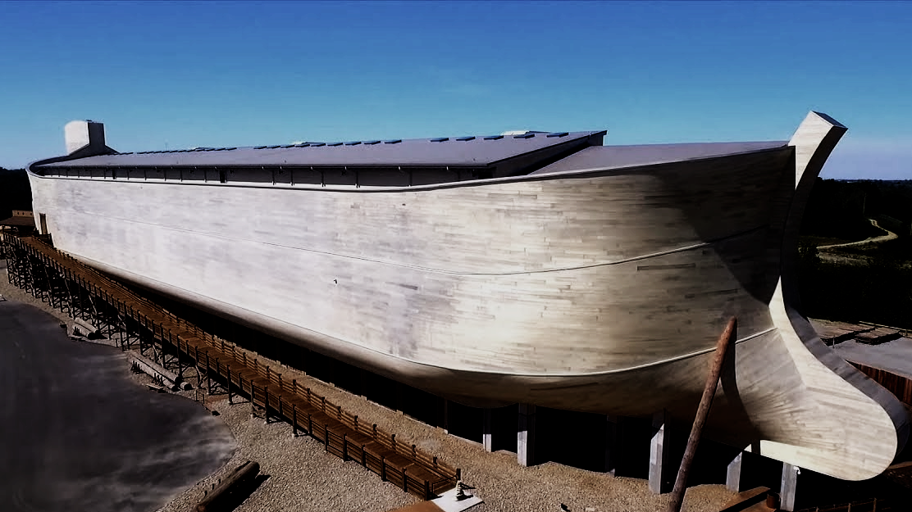
EVERYTHING SIGNIFICANT BEGINS WITH THE FIRST STEP
NOAH
GENESIS 6-9

Slide 8
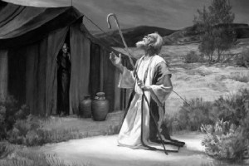
EVERYTHING SIGNIFICANT BEGINS WITH THE FIRST STEP
ABRAHAM
GENESIS 12:1-5

Slide 9
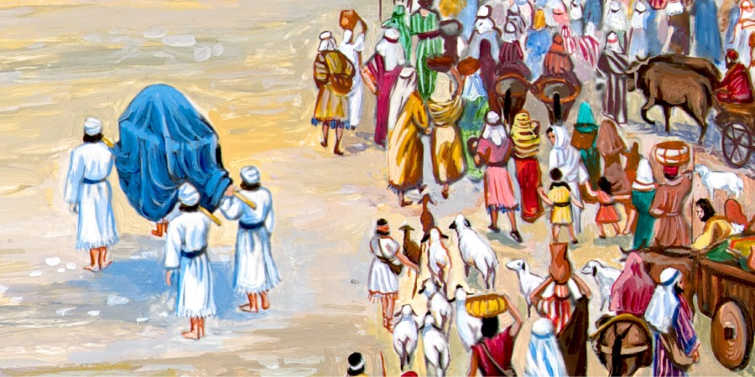
EVERYTHING SIGNIFICANT BEGINS WITH THE FIRST STEP
CROSSING THE
JORDAN
JOSHUA 3:1-7

Slide 10
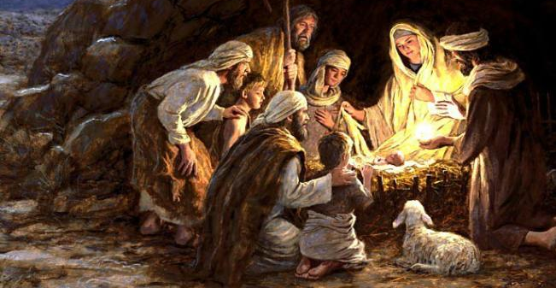
EVERYTHING SIGNIFICANT BEGINS WITH THE FIRST STEP
THE INCARNATION
PHILIPPIANS 2:5-8

Slide 11
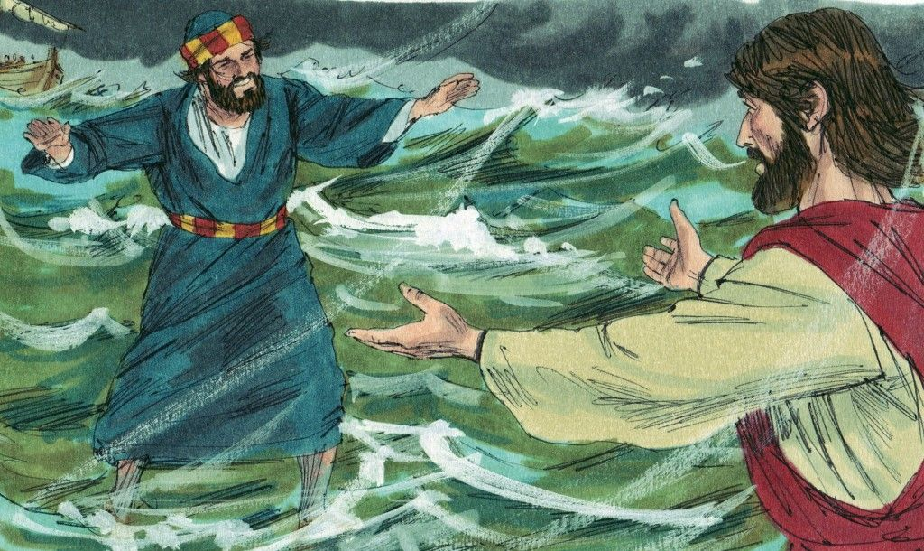
EVERYTHING SIGNIFICANT BEGINS WITH THE FIRST STEP
PETER WALKS ON WATER
MATTHEW 14:22-33

Slide 12
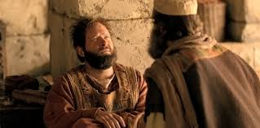
EVERYTHING SIGNIFICANT BEGINS WITH THE FIRST STEP
ANANIAS VISITS
PAUL
ACTS 9:10-16

Slide 13
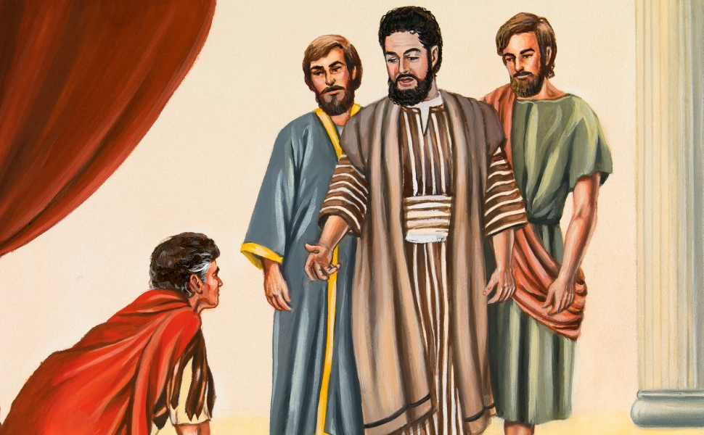
EVERYTHING SIGNIFICANT BEGINS WITH THE FIRST STEP
PETER and CORNELIUS
ACTS 10

Slide 14
WHAT SIGNIFICANT THING IS GOD CALLING YOU TO IN 2020?
It begins with the first step
Loving a difficult person
Forgiving a hurtful person
Serving in or starting a new ministry
Reprioritising finances
Witnessing to a resistant person
Trusting God vs worrying
Read your Bible and/or pray more
Physical / emotional healing
God has given you the Holy Spirit. His power will be there for you
when you take the first step

Slide 15
EVERYTHING SIGNIFICANT BEGINS WITH THE FIRST STEP
The story of James McQuilkin in Answers to prayer from the narratives of George Meuller pp. 37-38 compiled by A.E.C. BROOKS. Moody Press, Chicago 1983

